Slide 1
Spring 2026 Yucaipa
Growers
Tia Russell
California South Coast Vineyard Operations

Slide 2
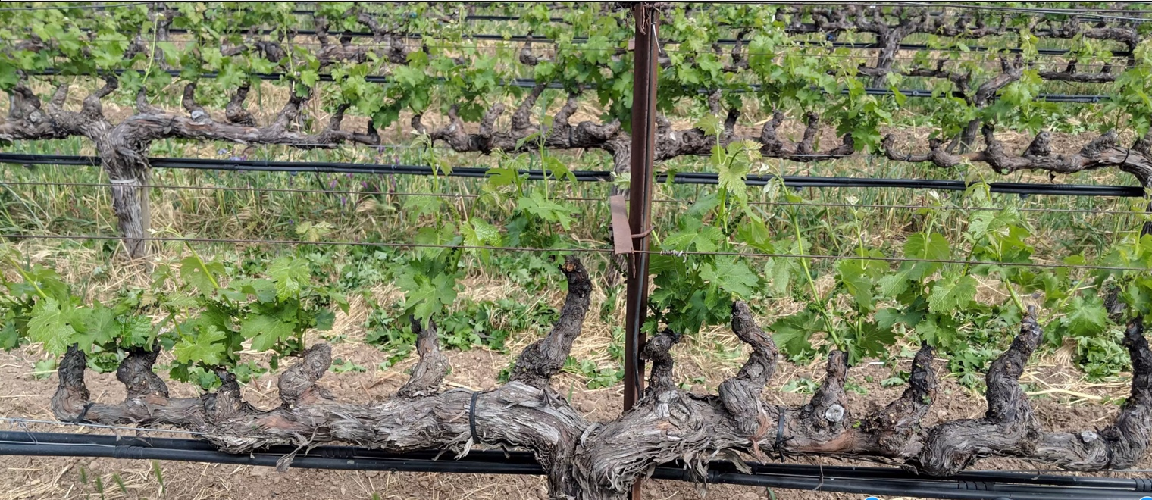
Pruning check in and clean up

Slide 3
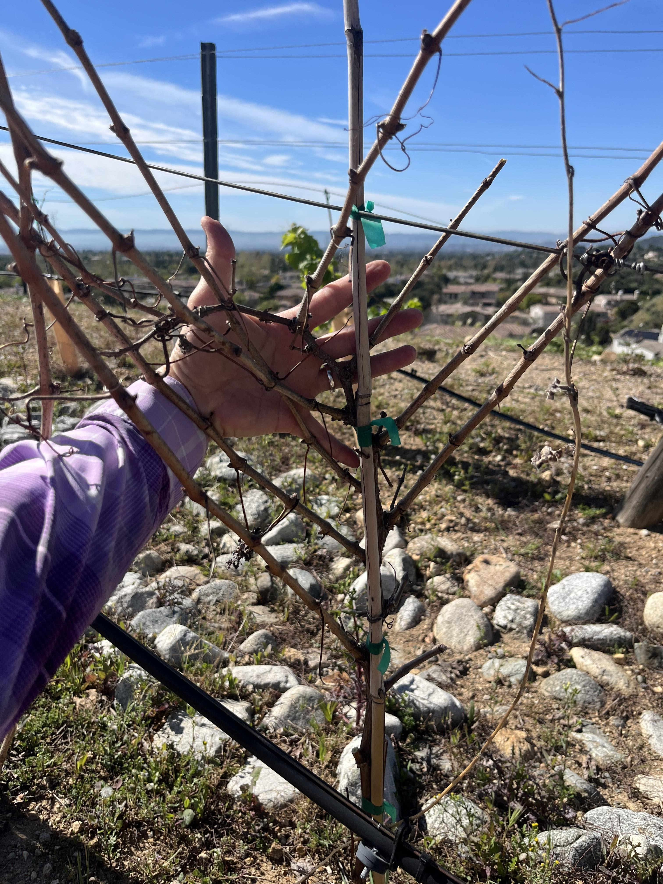
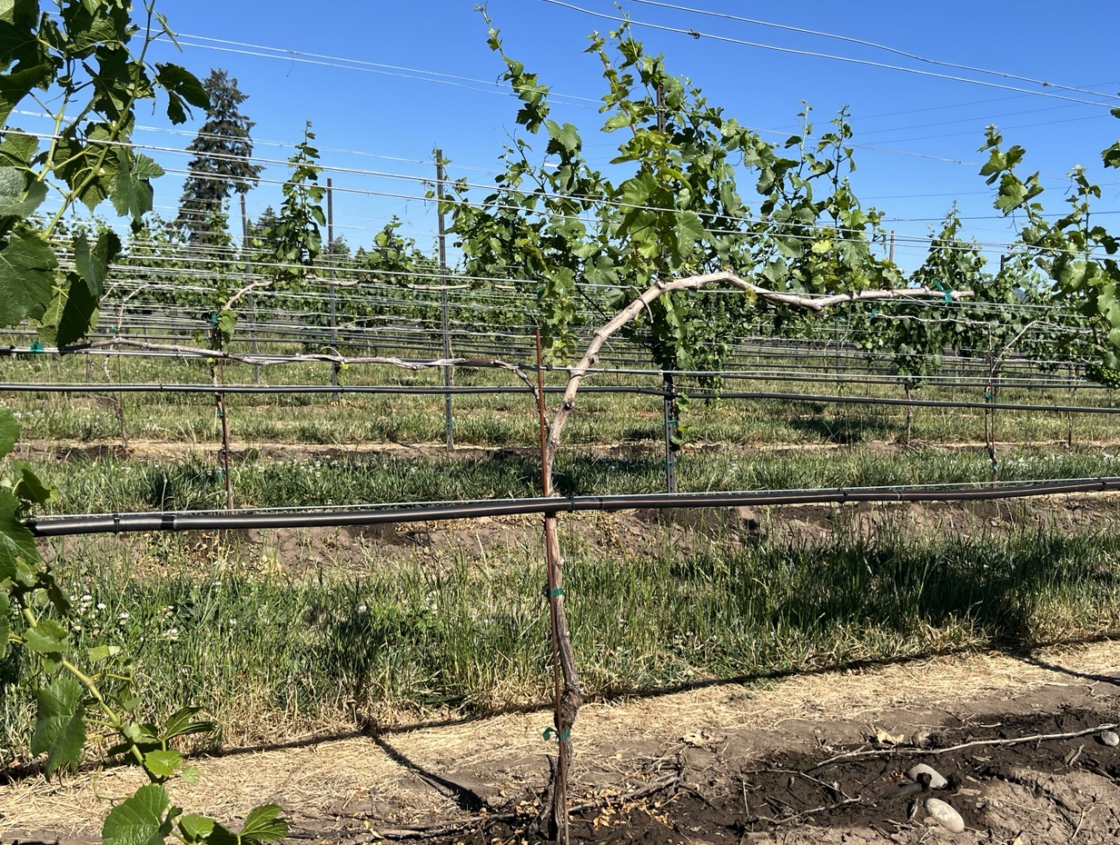
Train Young Vines for correct POSITION to reach the wire
California South Coast Vineyard Operations

Slide 4
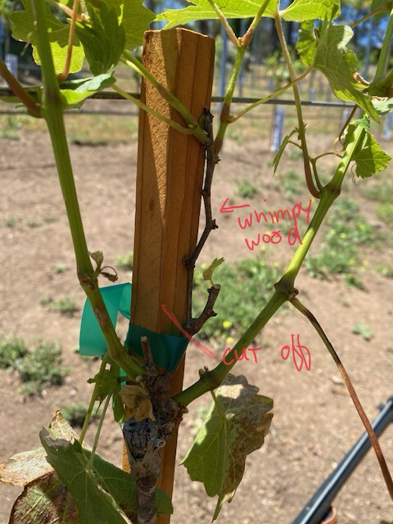
No Wimpy Wood = 3/8”
California South Coast Vineyard Operations

Slide 5
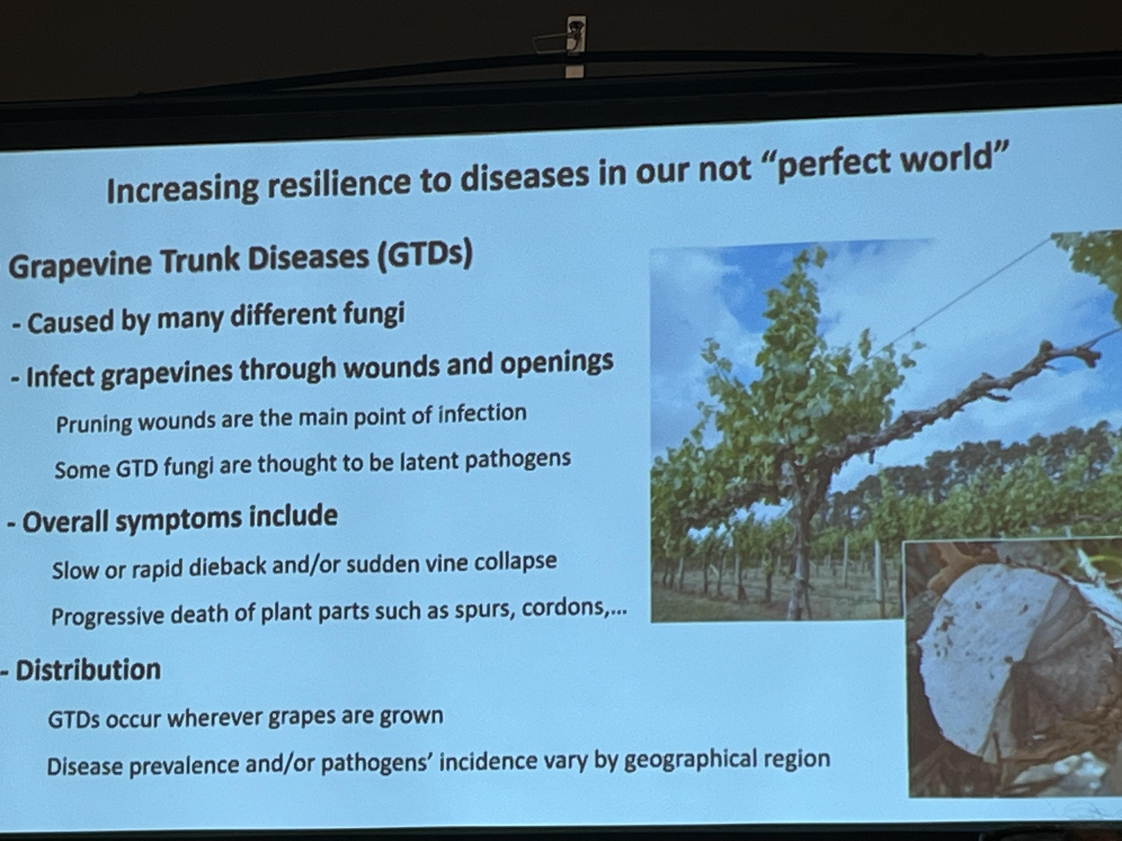
Grapevine Trunk Diseases (GTDs)
California South Coast Vineyard Operations

Slide 6
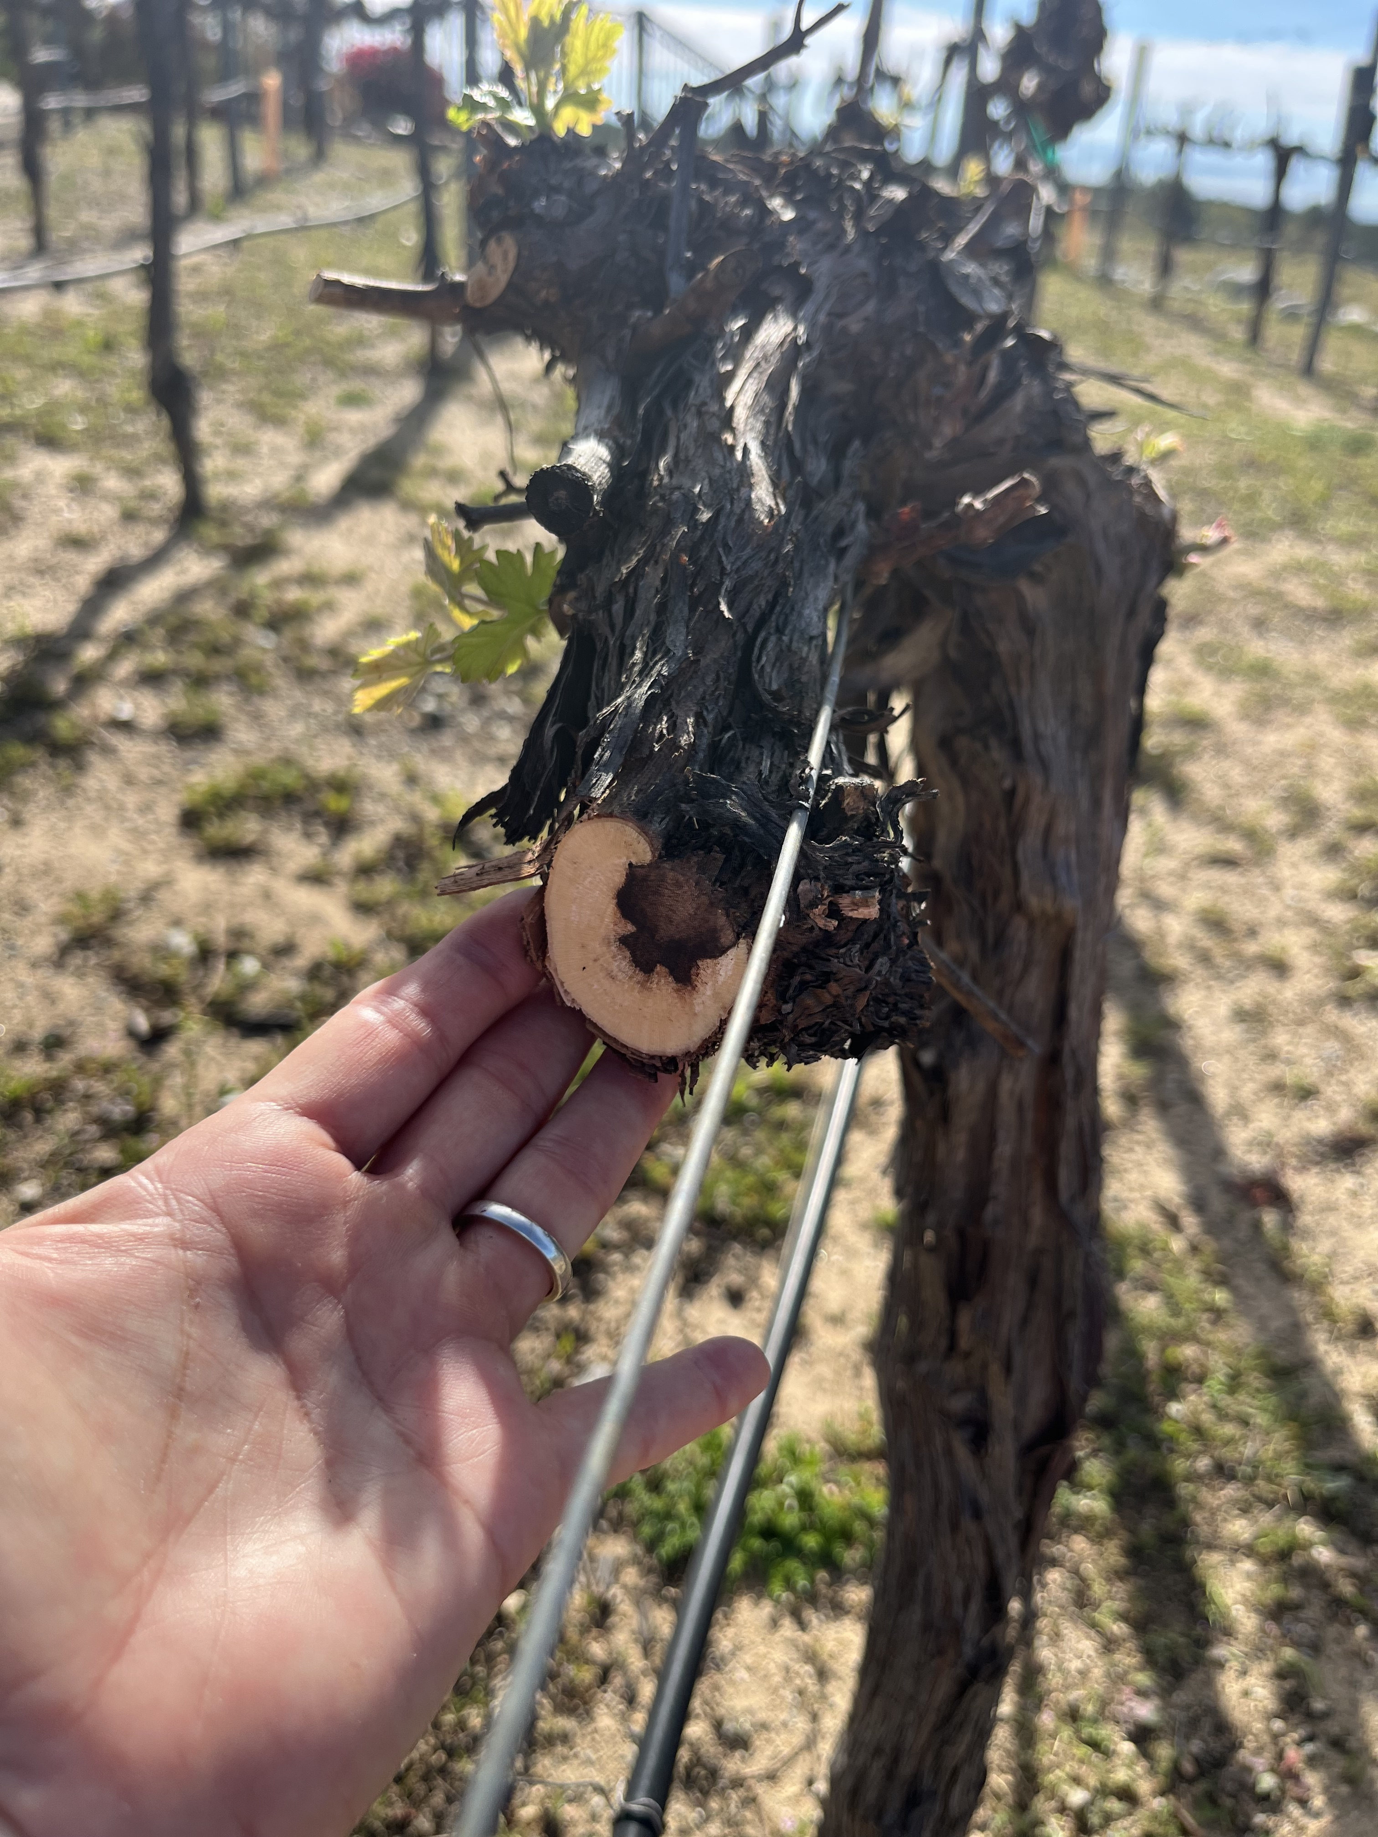
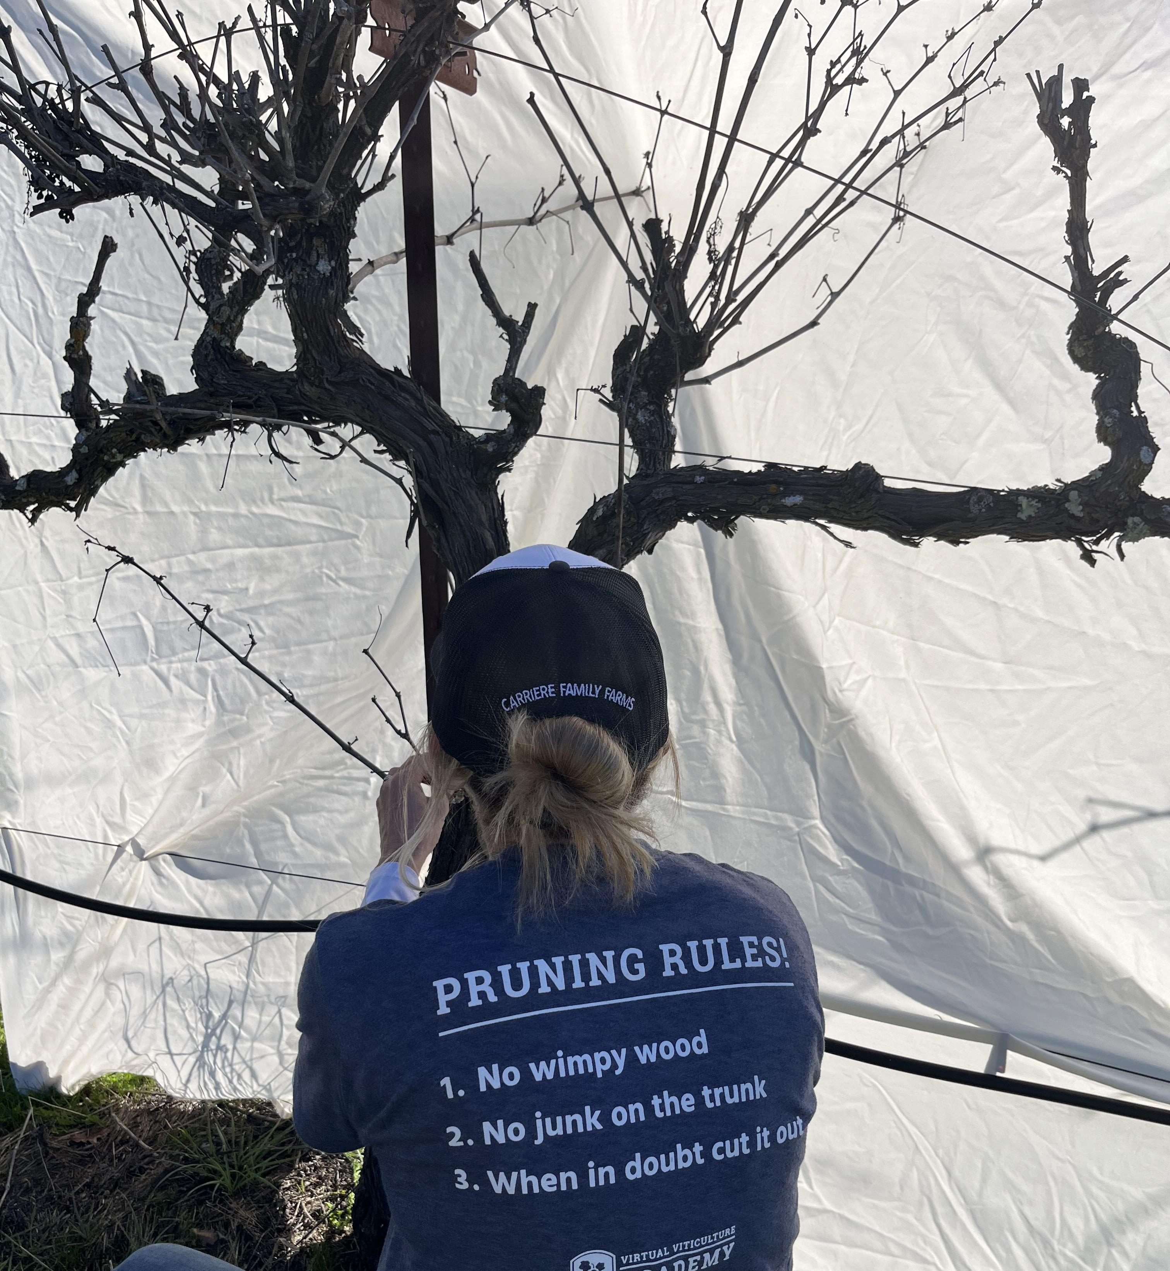
No Junk on the Trunk
California South Coast Vineyard Operations

Slide 7
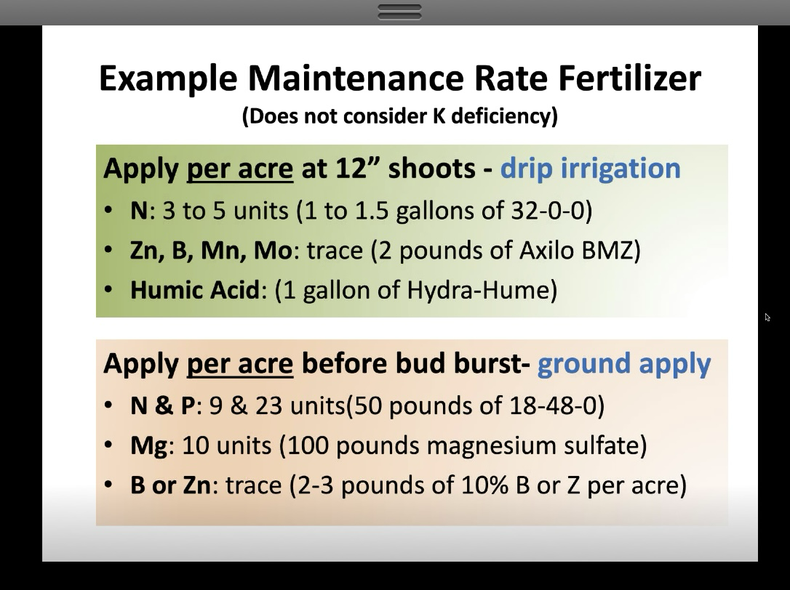

Slide 8
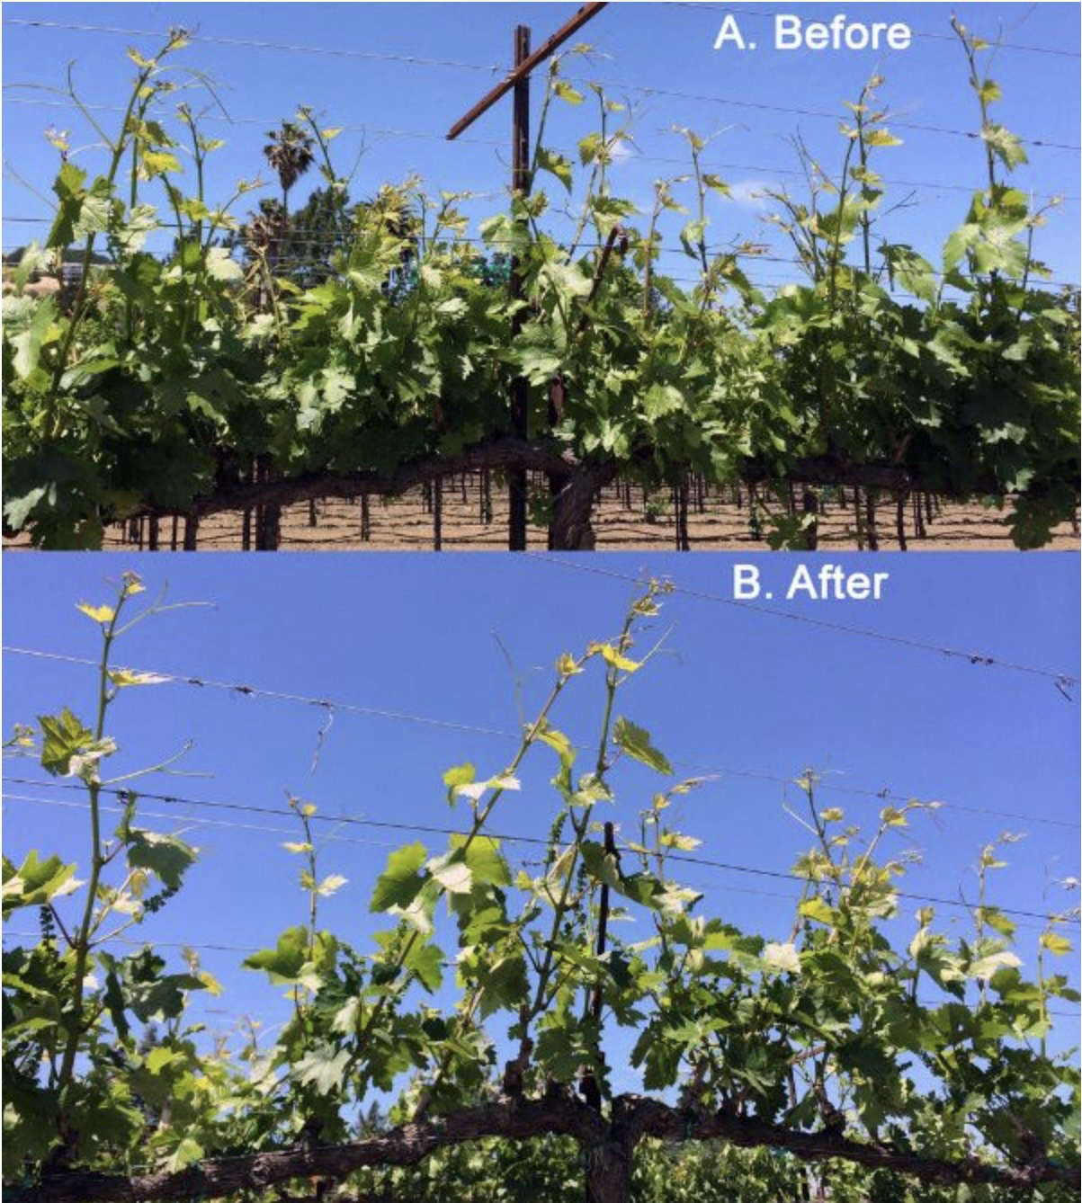
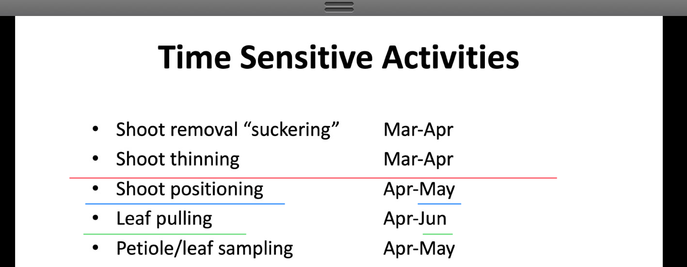
California South Coast Vineyard Operations

Slide 9
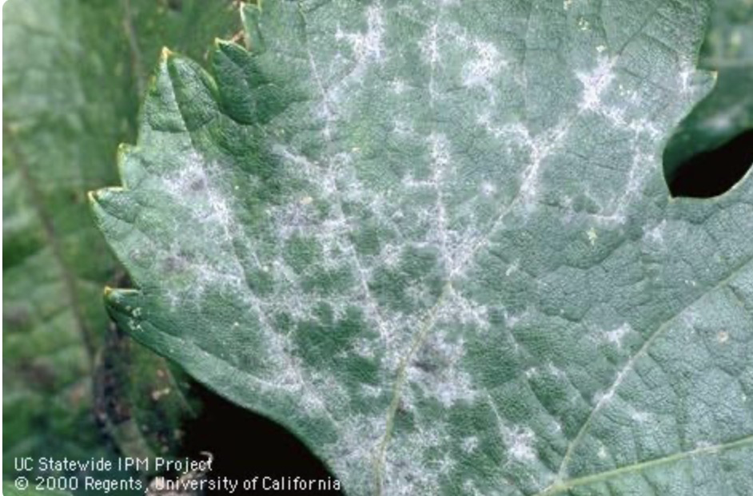
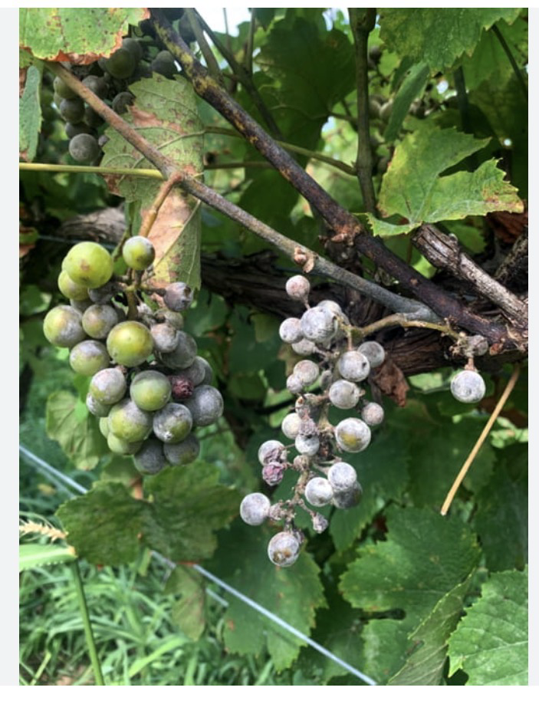
Powdery mildew
Critical period 3 weeks pre bloom to 3 weeks after bloom
California South Coast Vineyard Operations

Slide 10
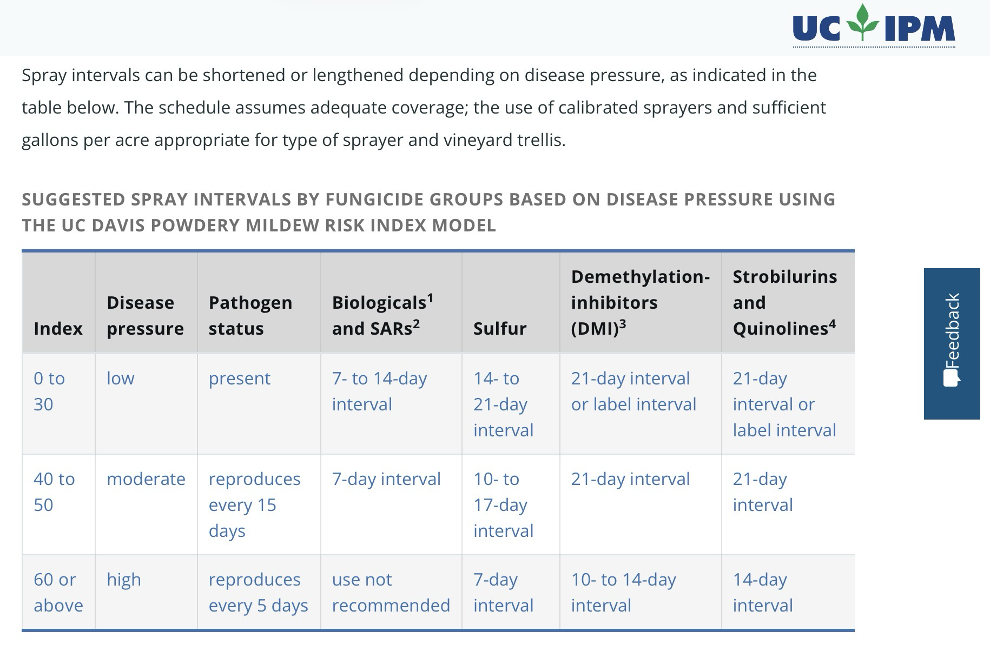
Demethylation Inhibitors = blocks the C14 demethylase enzyme and creates fungal cell membranes. Used in ag fungicides and human medical silencing tumor suppressors
Stro and Quin = disrupts mitochondrial respiration in fungi, starving them for energy
California South Coast Vineyard Operations

Slide 11
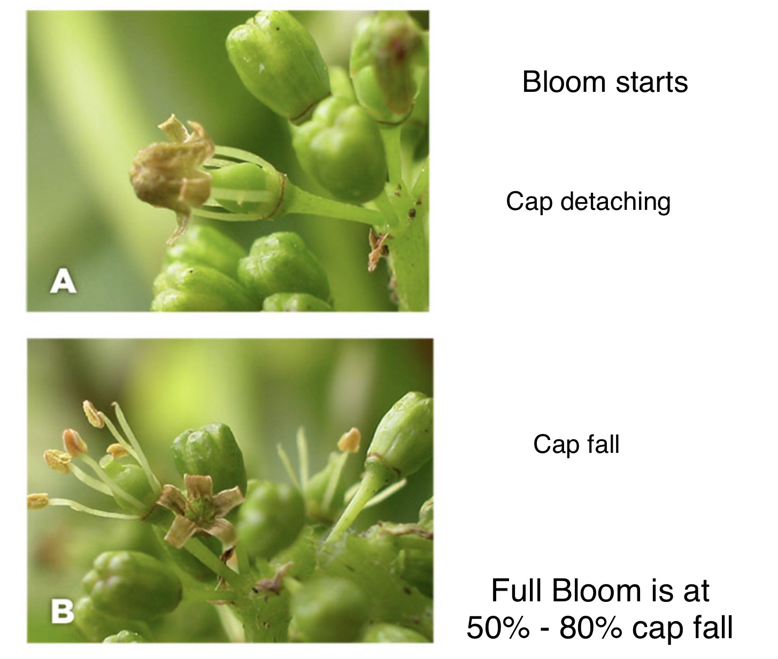
BLOOM: Fruit set is decided here.
Water or environmental Stress now = yield loss later.
California South Coast Vineyard Operations

Slide 12
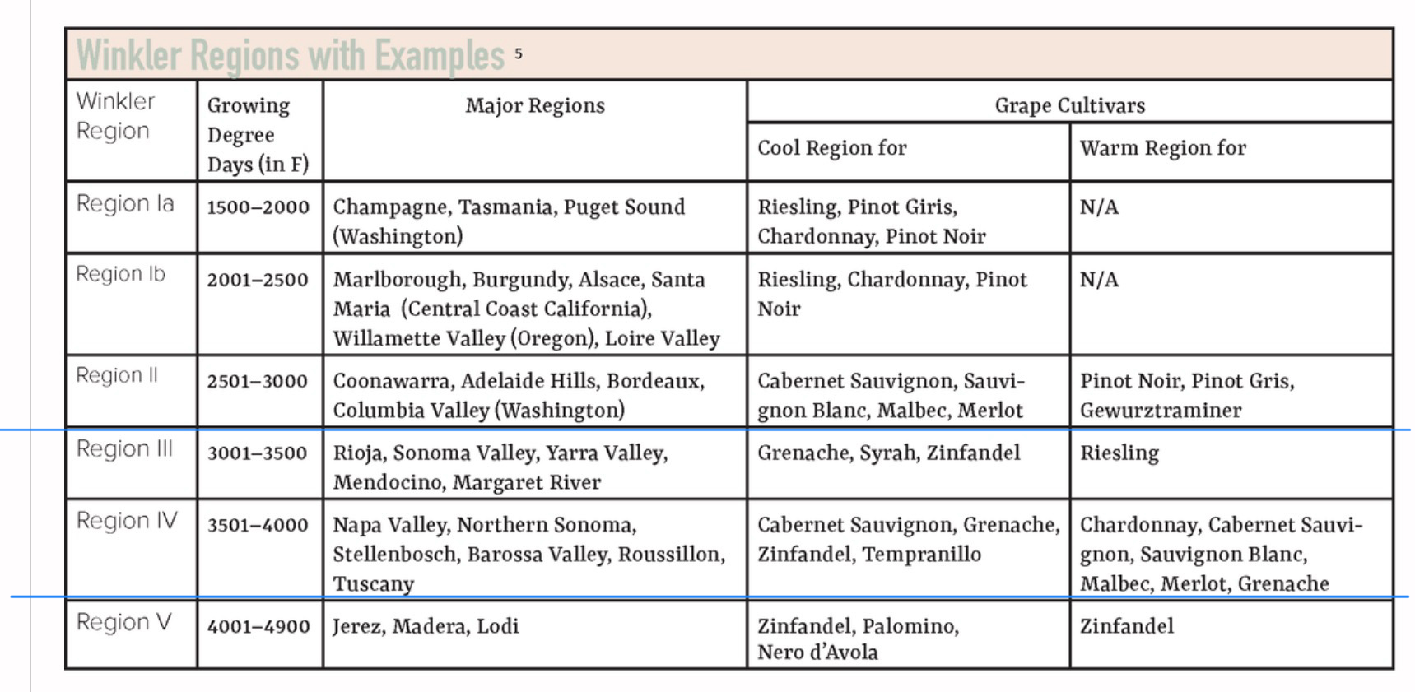
2024 GDD = 3400 – 3600
2025 GDD = 3300 – 3500
2015 GDD = 4100 – 4300
2005 GDD = 3100 3300
Winkler Region I – V is based on Growing Degree days needed to ripen particular varieties

Slide 13
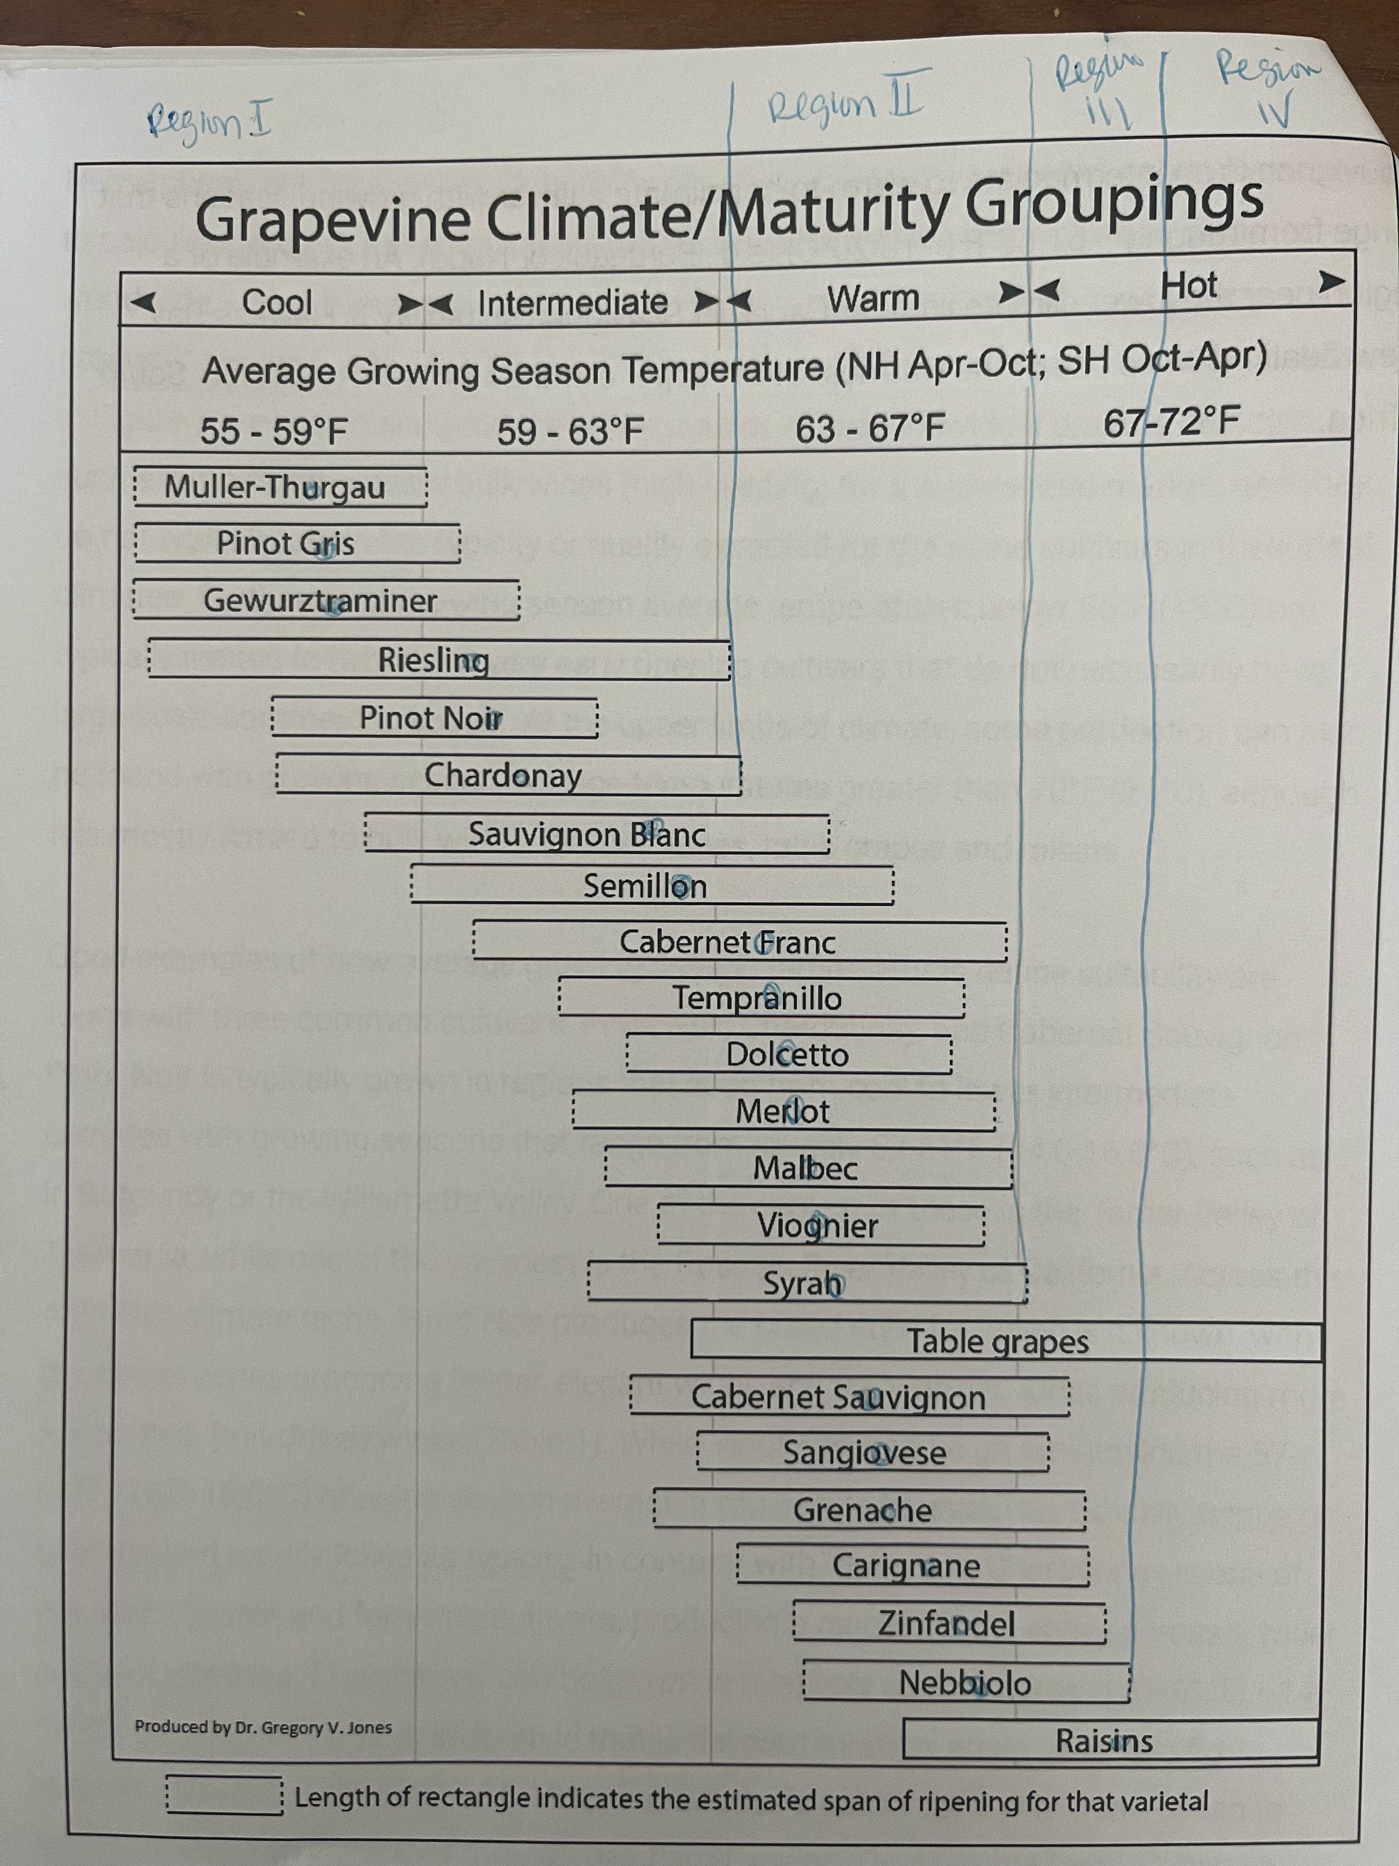
Climate Is a Gradient — Not a Line
Climate Maturity Grouping uses Growing season Average Temp (GST) from April to Oct.
Too cool = not reach physiological maturity; high acid and green unripe flavors
Too warm = ripen too fast, low acid, high alcohol, loss of character and aroma
California South Coast Vineyard Operations

Slide 14
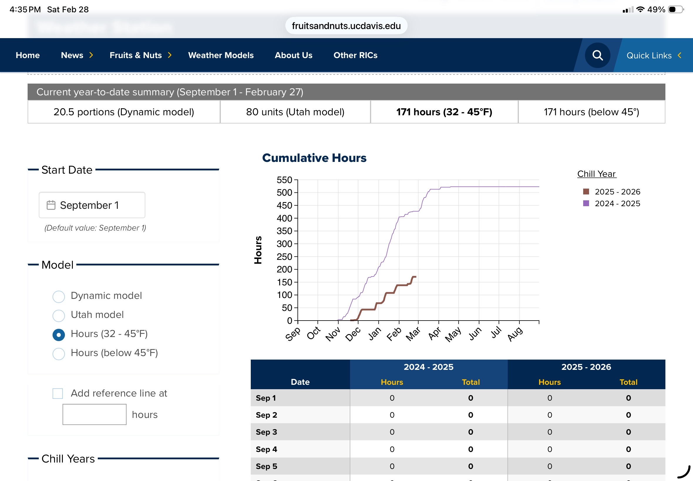
Lack of Chill leads to erratic, delayed or weak bud break .
Can result in reduced, uneven shoot development, poor fruit set, lower overall yield
California South Coast Vineyard Operations

Slide 15
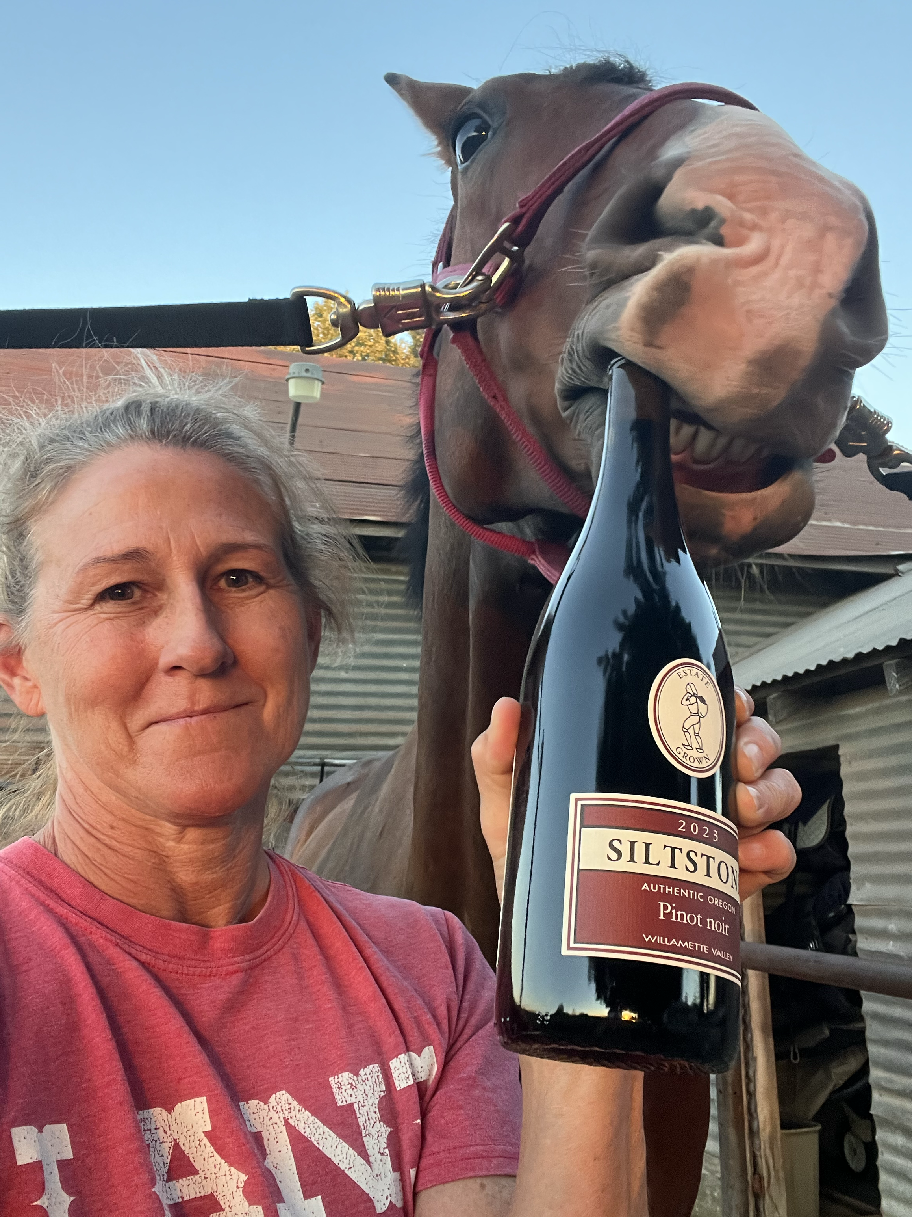
Tia Russell 209-815-2399 Tia.russell70@icloud.com

