Slide 1
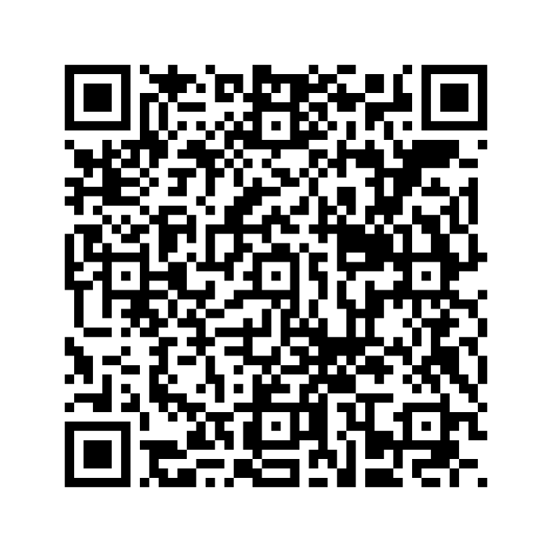
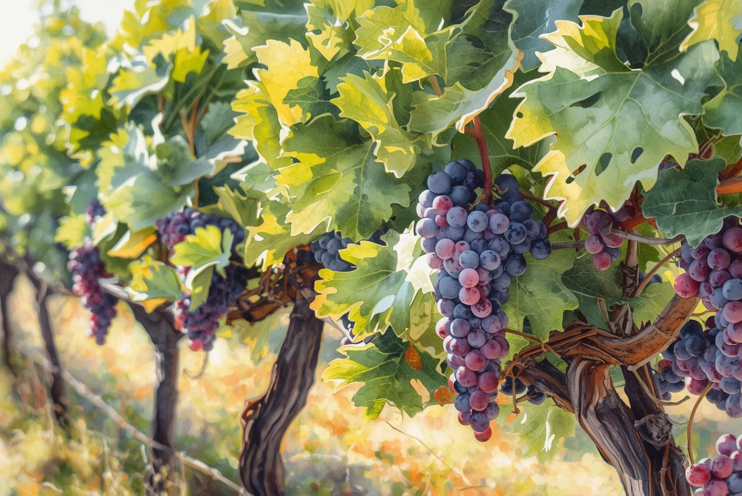
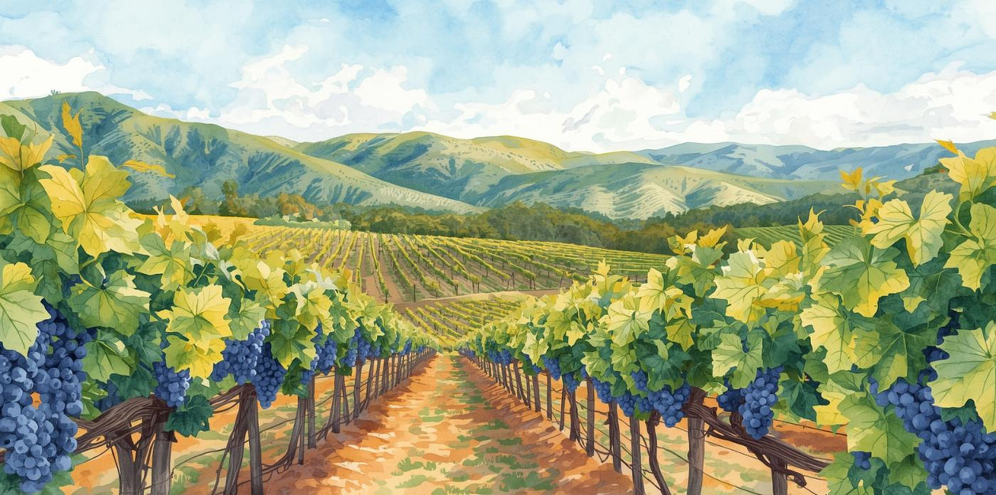
Voice of the Wine Industry
Wine Industry Coalition of Yucaipa Valley
March 1, 2026
1:00 pm

Slide 2
Voice of the Wine Industry
Wine Industry Coalition of Yucaipa Valley
March 1, 2026
1:00 pm

Slide 3
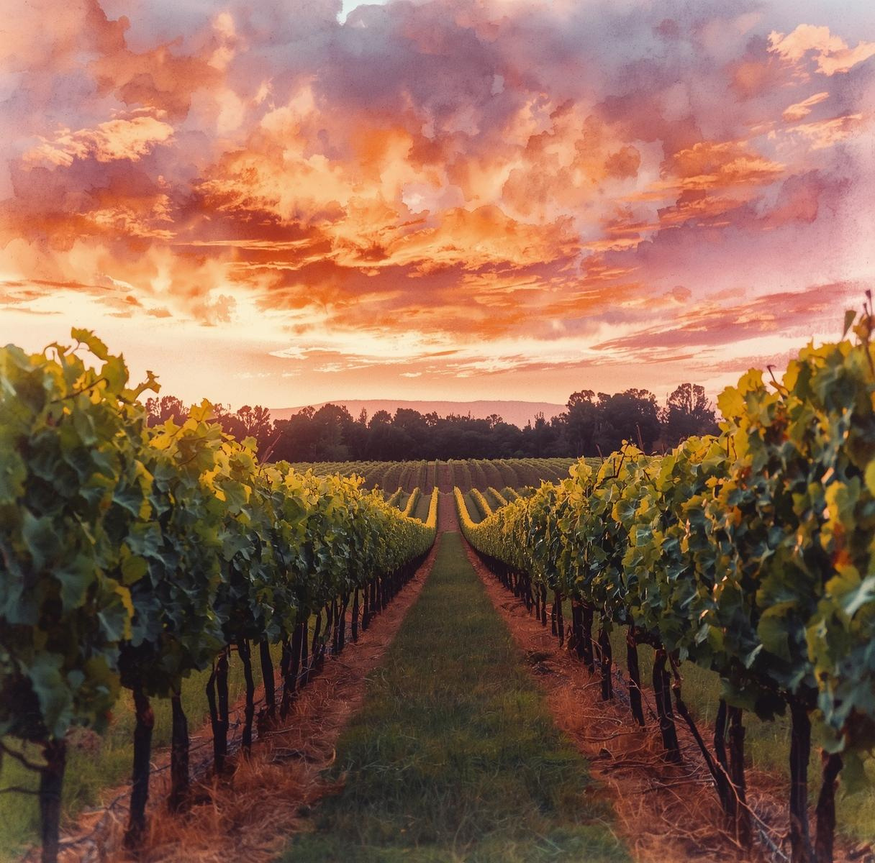
Event Overview
  Welcome & Coalition Introduction
  Guest & Community Remarks
  Seasonal Vineyard Education: Winter Pruning Presentation
    Tia Russell, Dave Wilson Nursery
  Grower & Resource Support Programs
    Madison Santiago, Inland Empire Resource Conservation District
  Winemaker Perspective
    Garrett York, Hermann York Winery
    Preston Todd, North Cork Vineyard
  Looking Ahead: Building Yucaipa Wine Country
  Community Q&A & Discussion

Slide 4
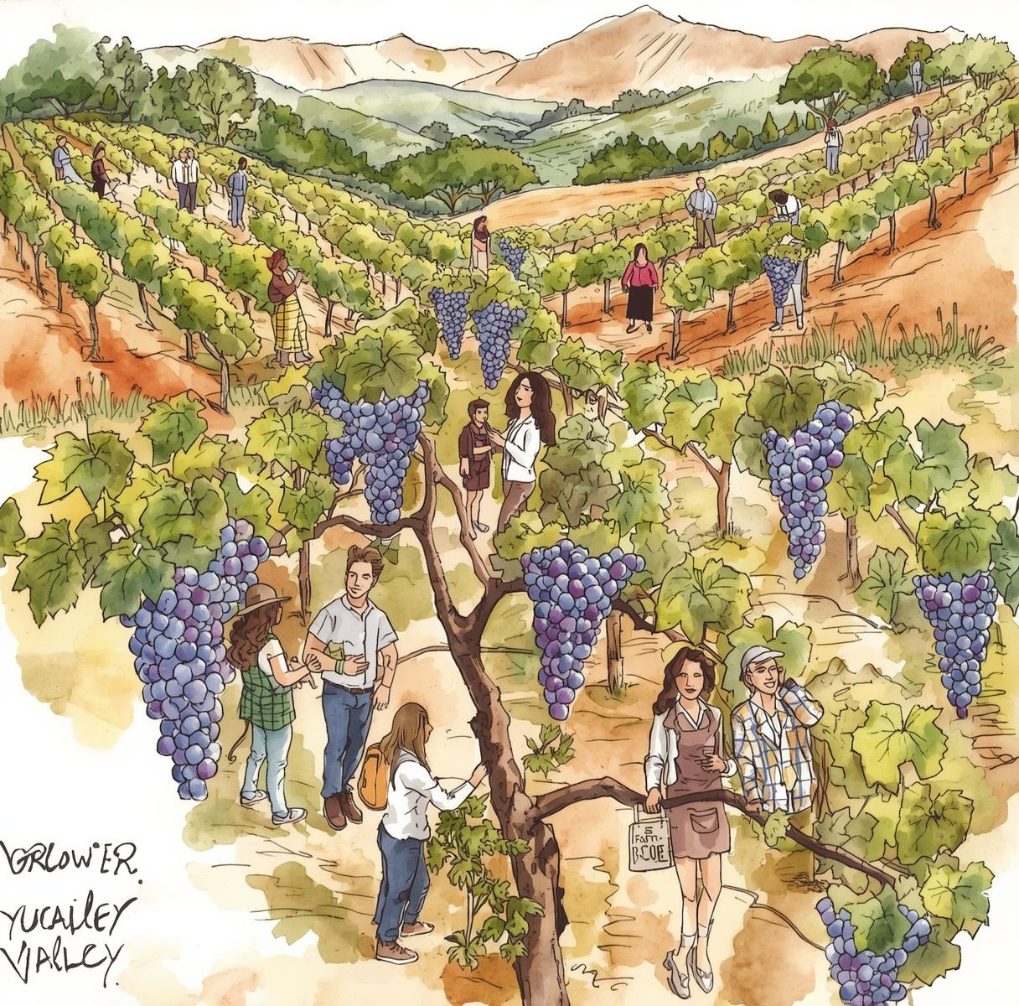
Welcome & Coalition Overview
Connecting the entire wine community of Yucaipa Valley together
The coalition creates alignment across the interconnected local wine ecosystem.

Slide 5
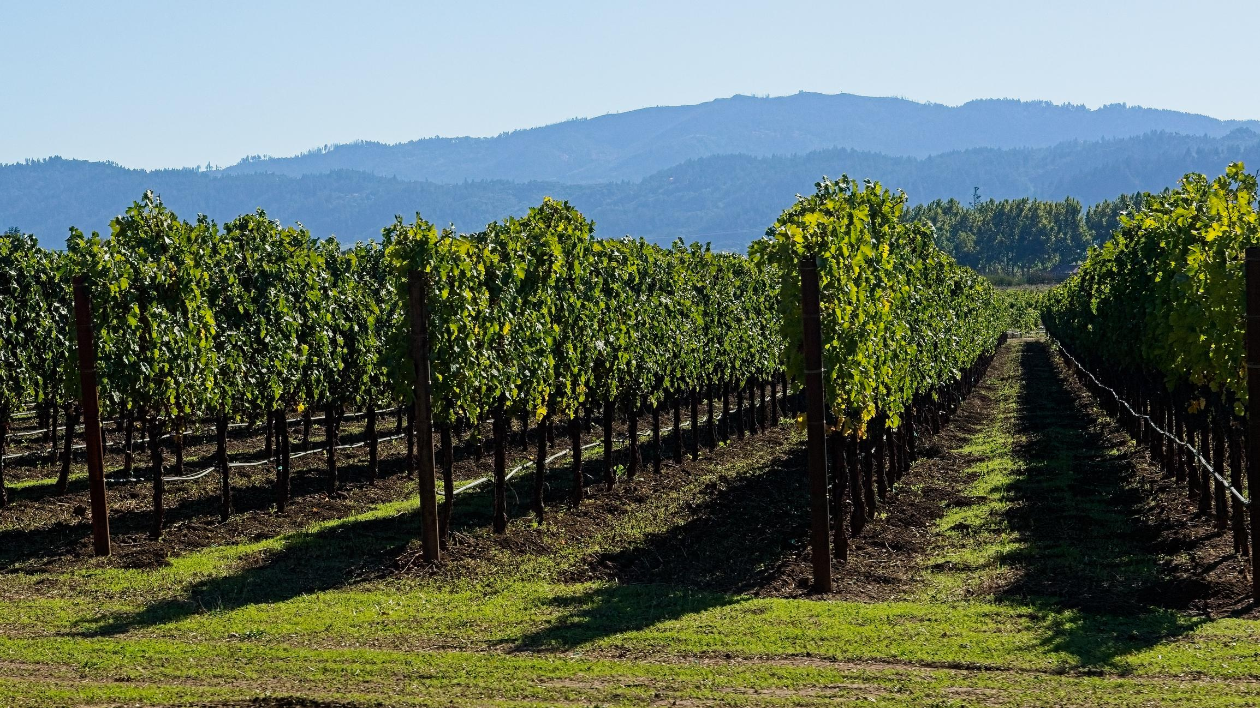
How many growers are shaping the Yucaipa Valley AVA?

Slide 6
How many growers are shaping the Yucaipa Valley AVA?
58

Slide 7
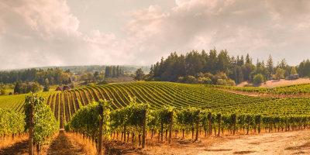
How Many Vines Are Planted Across the Yucaipa AVA?

Slide 8
How Many Vines Are Planted Across the Yucaipa AVA?
24,000+

Slide 9
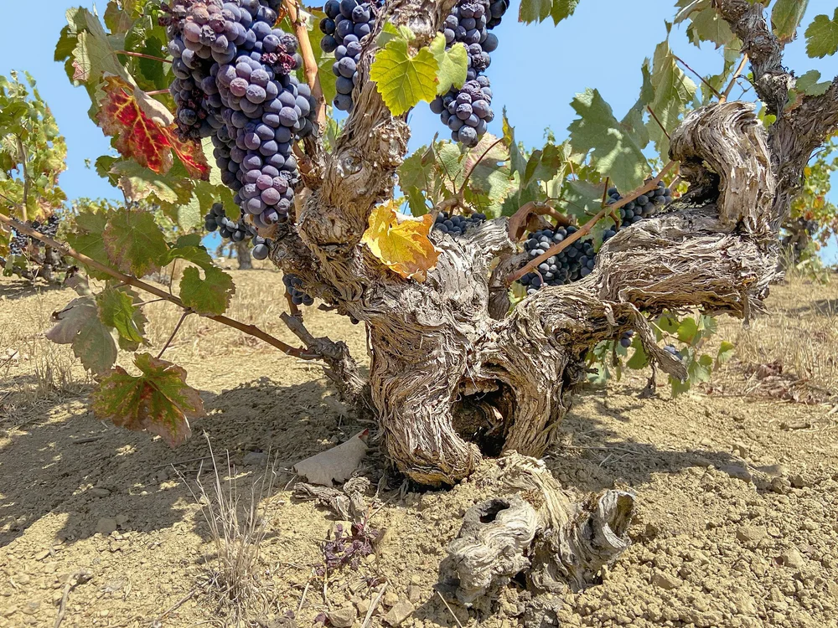
Yucaipa Valley AVA Snapshot (2026)
13 varietals
30–2,600 vines per grower
2,000 new vines projected

Slide 10
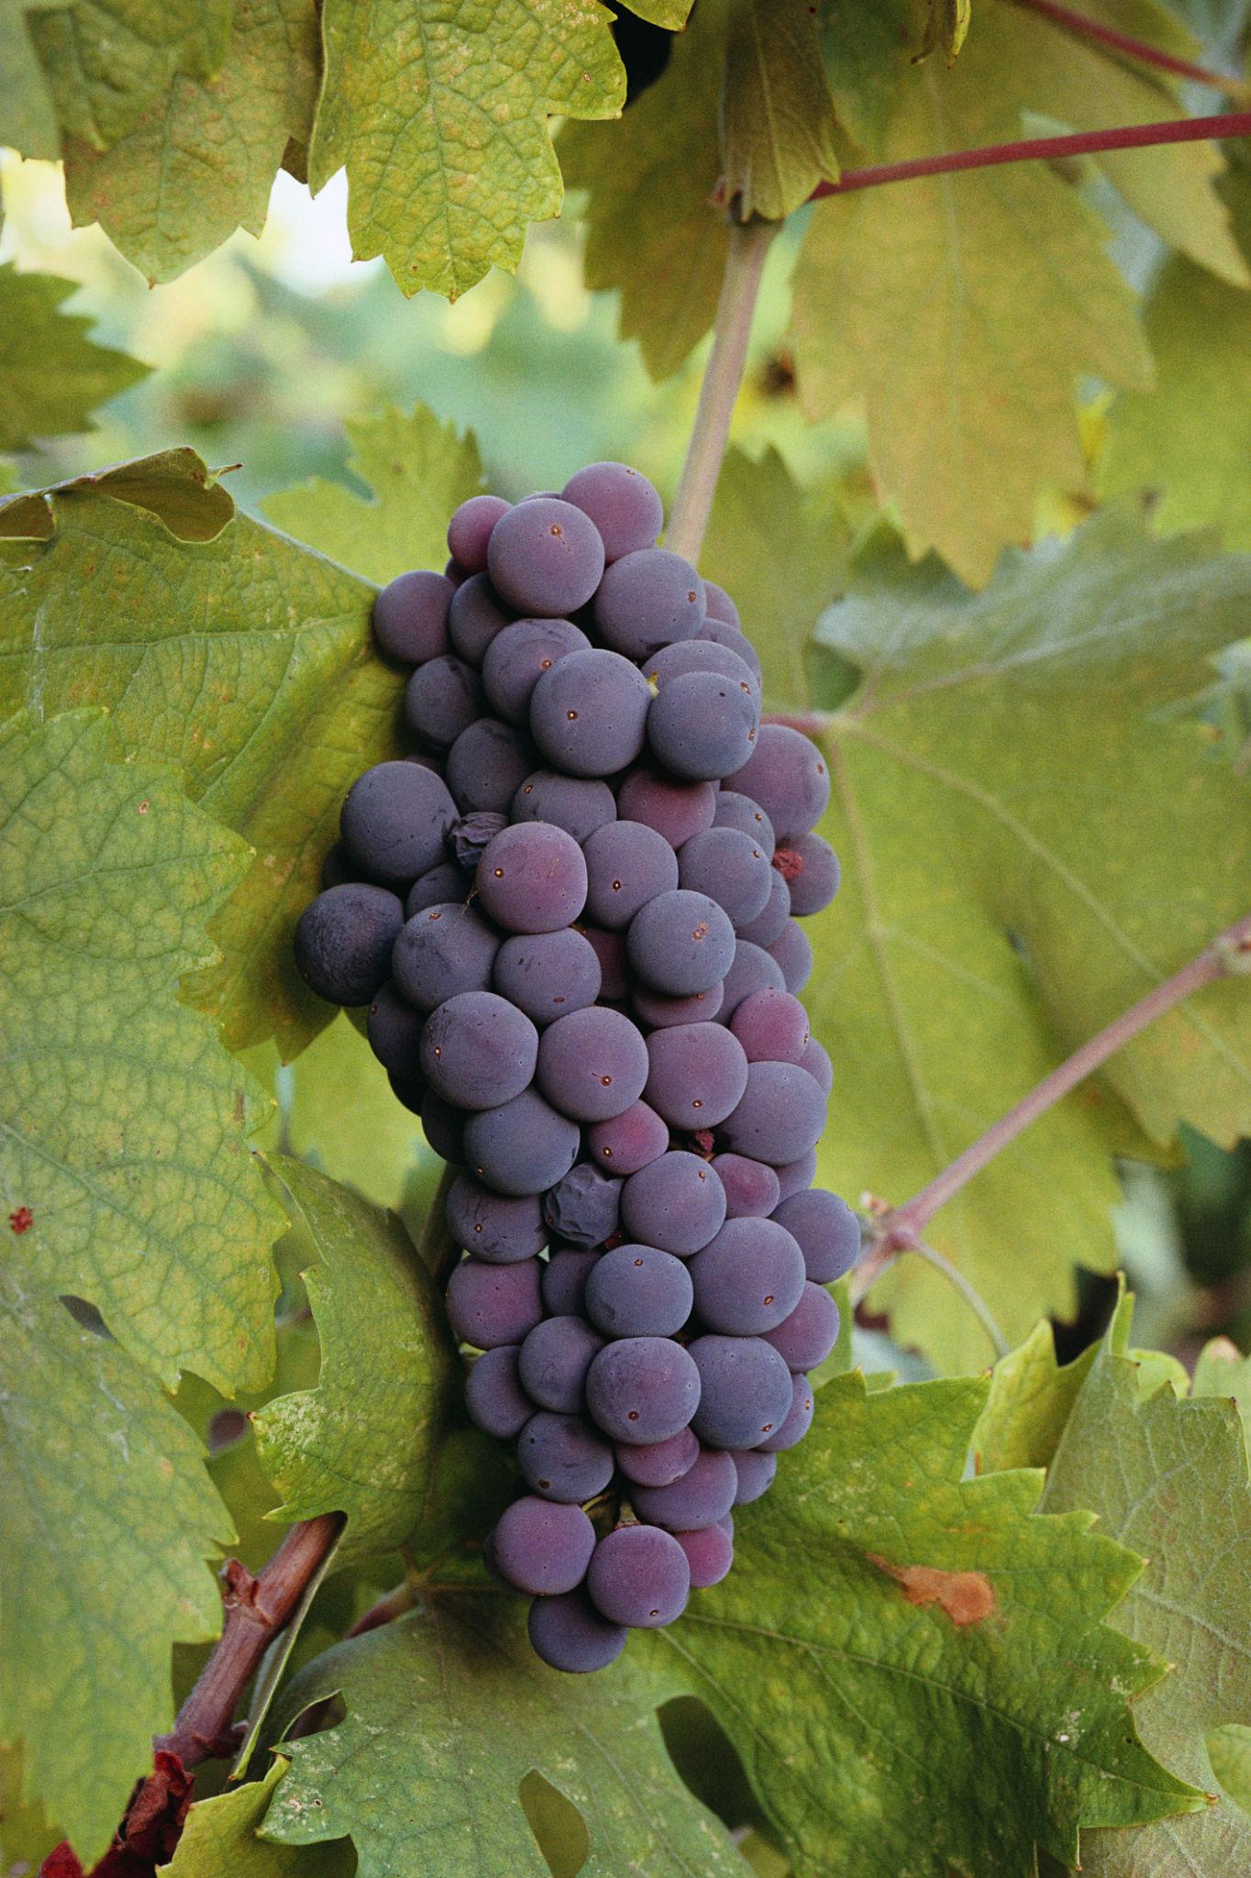
Most Common Varietals Planted in Yucaipa Valley AVA
Cabernet Sauvignon
Zinfandel
Barbera
Grenache
Malbec
Syrah
Primitivo
Fiano
Mourvèdre

Slide 11
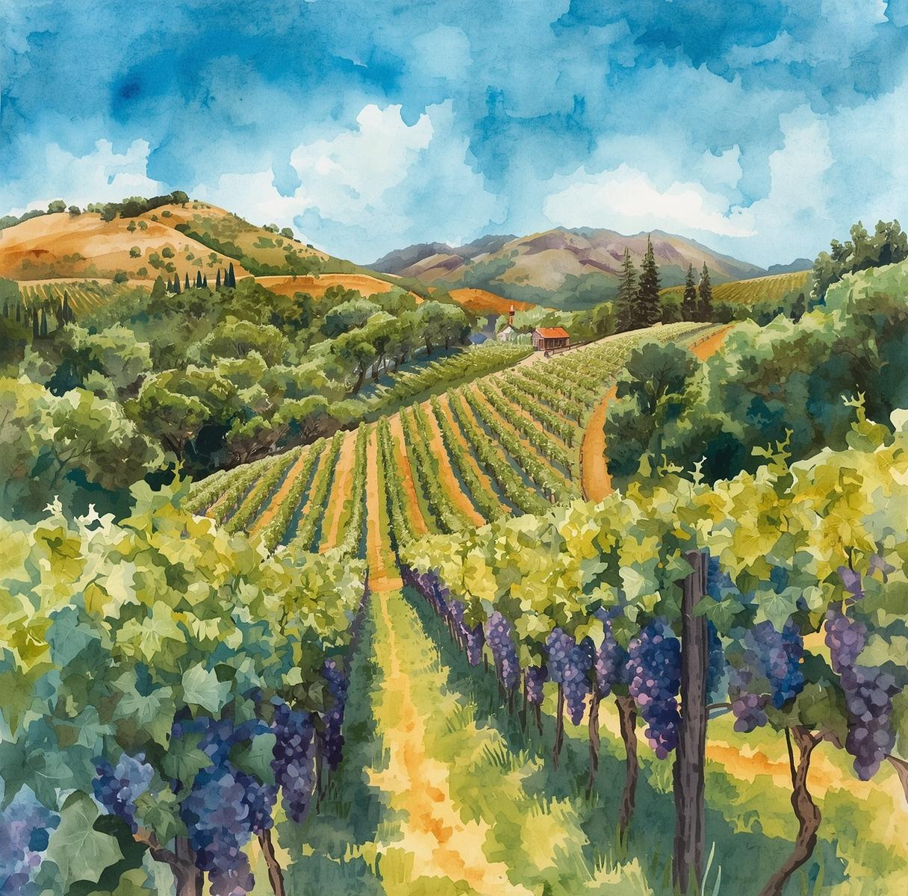
Guest and Community Remarks
Connecting the Wine Community in Yucaipa Valley for Success
The Wine Industry Coalition of Yucaipa Valley fosters collaboration among all wine industry stakeholders.

Slide 12
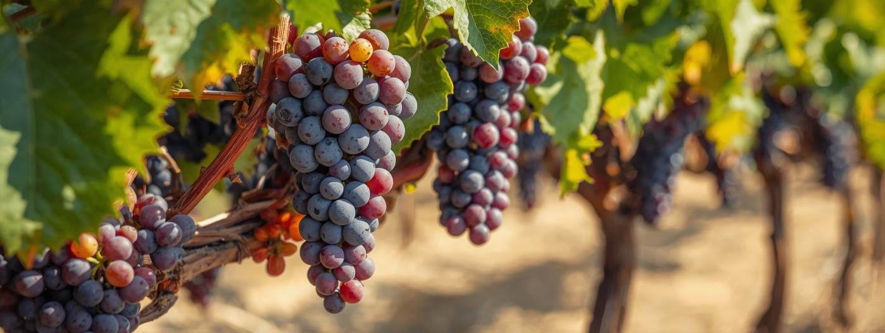
Seasonal Vineyard Education: Winter Pruning Presentation
By Tia Russell, Dave Wilson Nursery

Slide 13
Grower & Resource Support
Madison Santiago, Inland Empire Resource Conservation District

Slide 14
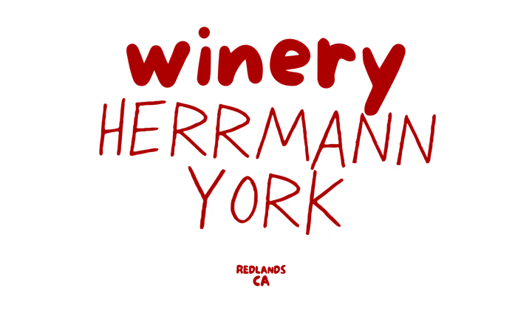

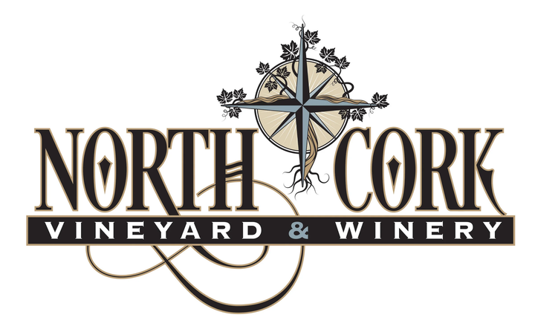
Winemaker Perspective
Garrett York, Hermann York Winery
Preston Todd, North Cork Vineyard

Slide 15
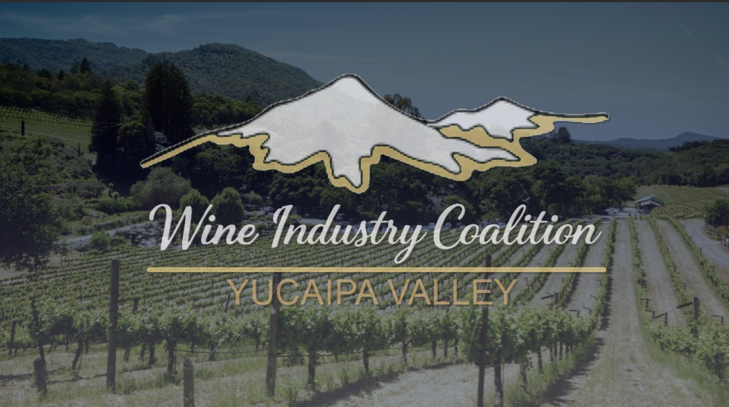
Looking Ahead
Introducing the Wine Industry Coalition of Yucaipa Valley
Bringing together growers, winemakers, distributors, hospitality, and suppliers to strengthen our local wine industry

Slide 16
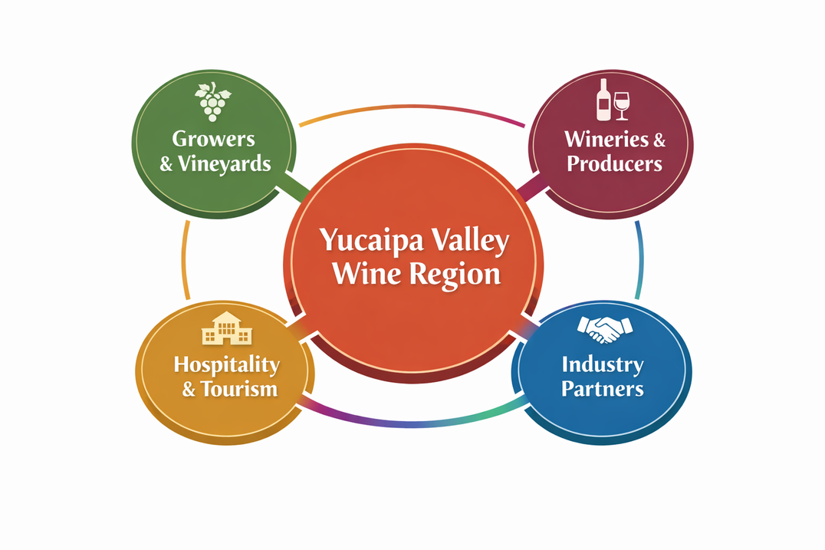
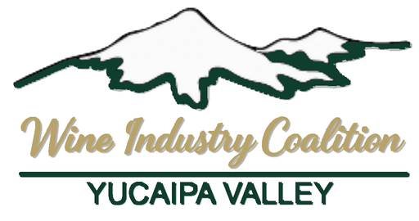
What is the Wine Industry Coalition of Yucaipa Valley?
A regional coalition supporting the full Yucaipa Valley wine ecosystem.

Slide 17
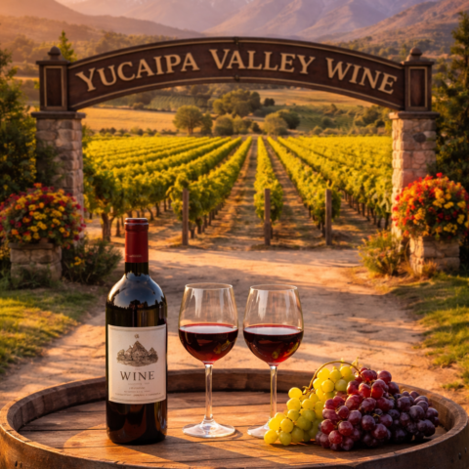



At a Glance
WICYV
CONNECT
Create a shared table for collaboration across the Yucaipa Valley wine ecosystem, bringing together growers, producers, hospitality partners, and local stakeholders.
REPRESENT
Support a cohesive regional identity by aligning voices, priorities, and perspectives that reflect the collective interests of the valley’s wine community.
STRENGTHEN
Build long-term resilience through coordination, shared knowledge, and efforts that strengthen the visibility and viability of the region.

Slide 18


Purpose and Approach
Purpose
Approach
Strengthen the long-term viability and visibility of the Yucaipa Valley wine region.
  Provide a platform for shared problem-solving
  Support coordinated regional efforts
  Build conditions for responsible, sustainable growth
  Strengthen the region — everyone together
An ecosystem-based view of wine in the Yucaipa Valley.
Wine is influenced by:
• Land • Water • Climate • Labor • Infrastructure
• Hospitality • Community
We bring these voices into the same conversation.
A Strong Region Benefits Everyone Within It.

Slide 19
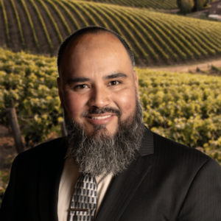
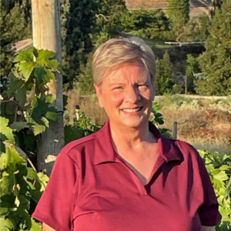
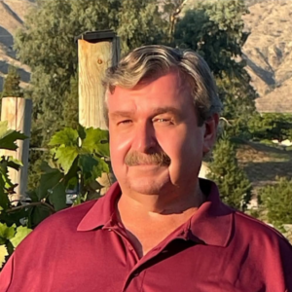
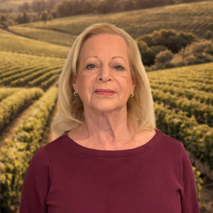
Meet the Board
WICYV’s leadership approach is rooted in coordination, trust, and practical engagement. Rather than acting as a regulatory or marketing body, the coalition serves as a convening platform—bringing together voices that shape the region and creating space for shared problem-solving and alignment.
Cesar Roldan
President
Donna Snodgrass
Vice President
Ray Snodgrass
Treasurer
Anita Matlock
Secretary

Slide 20
Why Become a Member?
  Regional Visibility
    Be publicly listed in the Yucaipa Valley wine directory and regional wine map — positioning your organization within the broader ecosystem.
  Coordinated Influence
    Participate in aligned regional efforts that strengthen the identity and direction of the valley.
  Industry Access
    Gain access to members-only updates, shared documents, and collaborative discussions.
  Meaningful Collaboration
    Engage in events, working sessions, and initiatives that individual businesses may not pursue alone.
  Stewardship & Long-Term Growth
    Support a coordinated regional approach that strengthens the viability of wine in Yucaipa Valley.

Slide 21
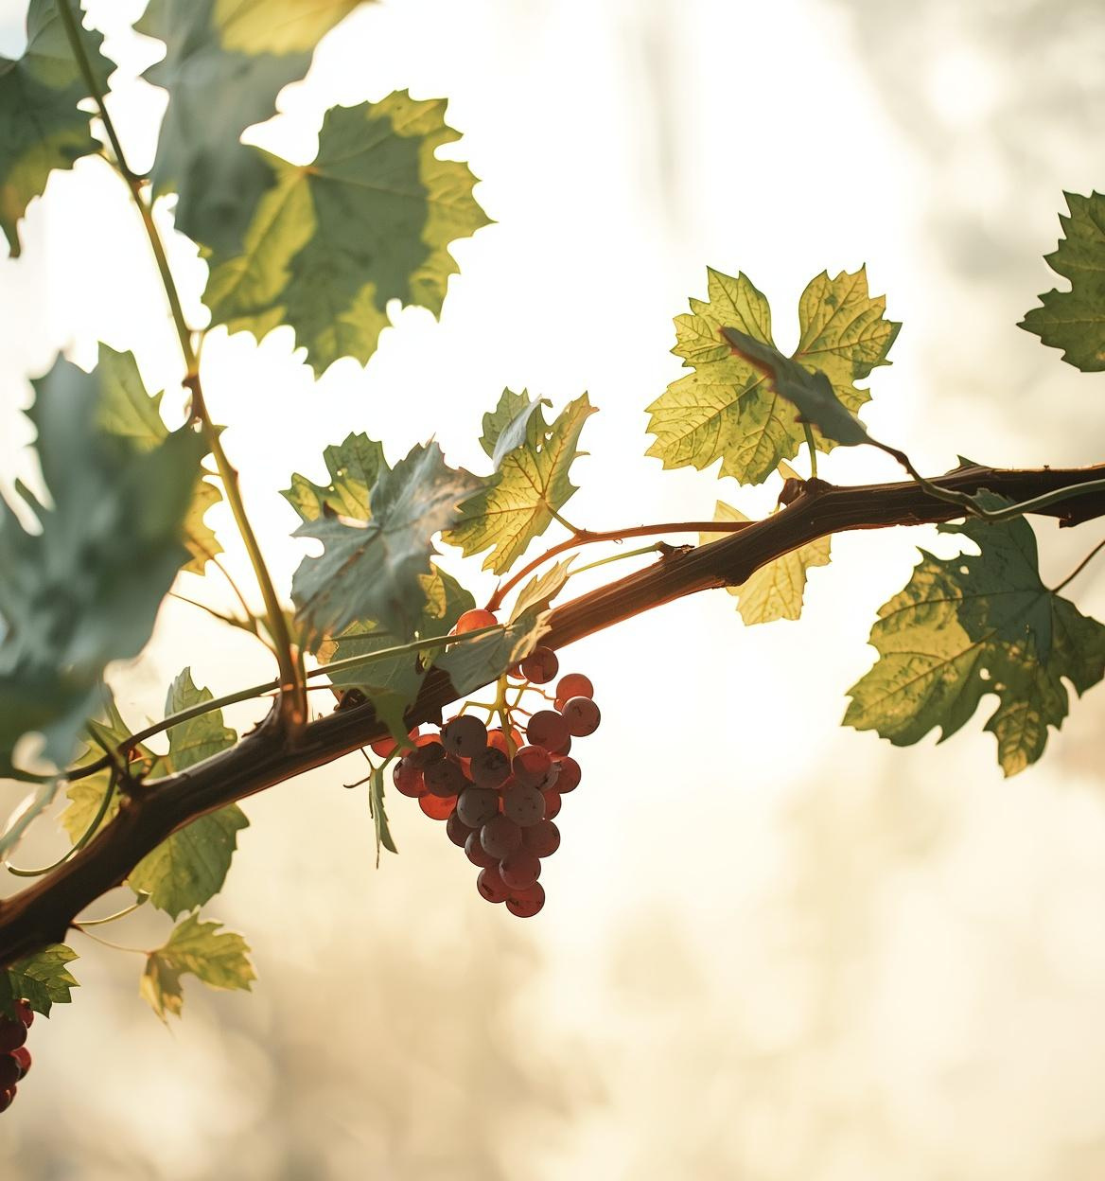
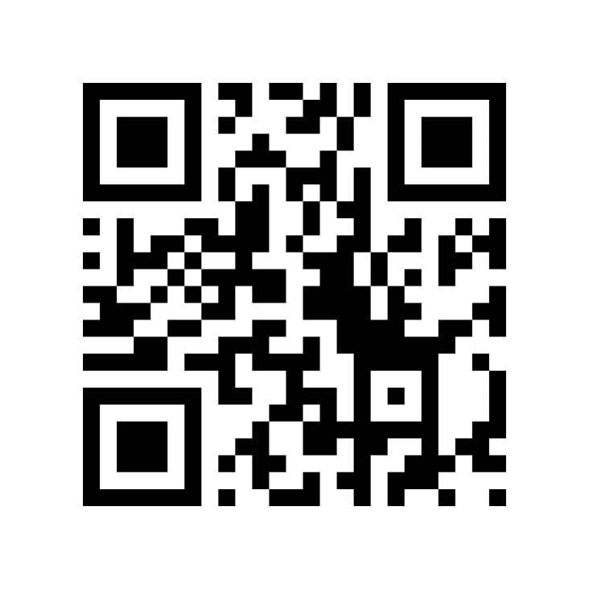
Join the Coalition
Email
wicyucaipavalley@gmail.com
Website
https://wicyv.com/
Facebook
https://www.facebook.com/people/Wine-Industry-Coalition-of-Yucaipa-Valley-WICYV

